Slide 1
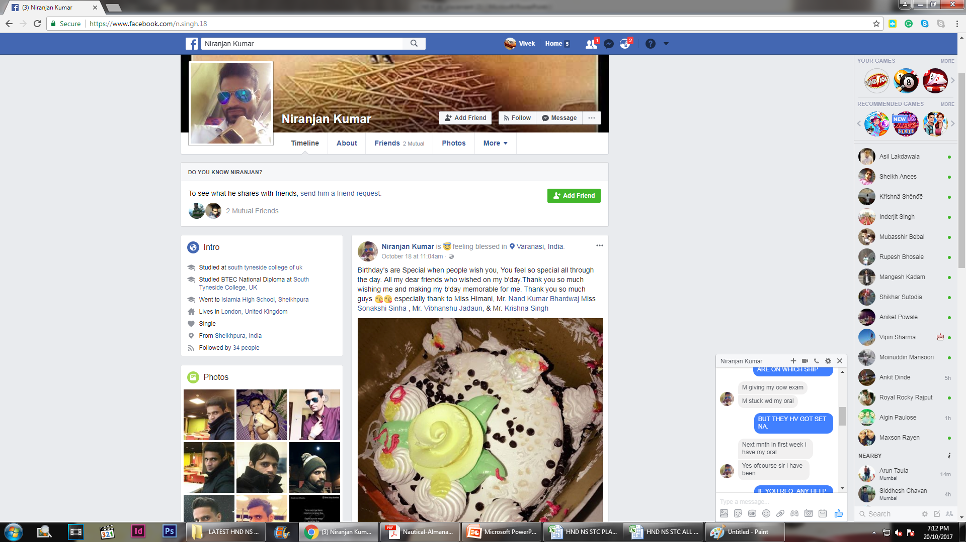
04/90 NIRANJAN KUMAR

